Slide 1

HARDWARE OF PERSONAL COMPUTER
Present By
Abdul Ghofir, M.Kom

Slide 2
What is Hardware?
It is the general term that is used to describe physical artifacts of a technology

Slide 3
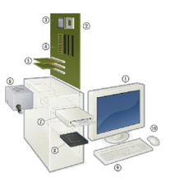
The Basic Hardware of Personal Computer
Monitor
Motherboard
CPU (Microprocessor)
Primary Storage (RAM)
Expansion cards
Power supply
Optical disc drive
Secondary storage (hard disk)
Keyboard
Mouse

Slide 4
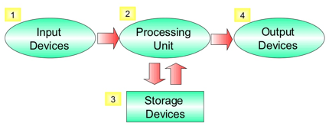
Hardware Classification

Slide 5
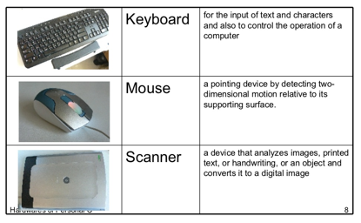
Input Device
A hardware mechanism that transforms information in the external world for consumption by a computer.

Slide 6
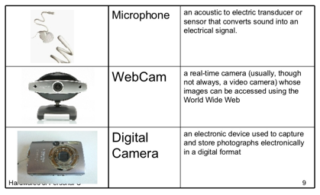
Input Device

Slide 7
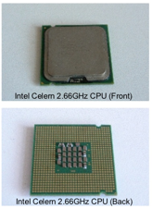
Processing Unit
A central processing unit (CPU) is the component in the digital computer that interprets computer program instructions and process data.
There 2 major CPU manufacturers for personal computers
Intel
www.intel.com
AMD
www.amd.com

Slide 8
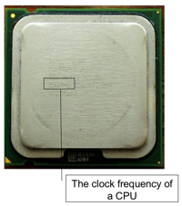
Processing Unit
How fast a CPU?
When you choose a CPU, you should consider its speeds.
The speed of CPU is determined by 2 main factors.
Clock frequency
Amount of cache memory
The higher the value, the faster the CPU will be.

Slide 9
Processing Unit
Intel CPU Families for Desktop Computer
Core processor
http://www.intel.com/products/desktop/processors/index.htm
Pentium processor
http://www.intel.com/products/desktop/processors/pentium.htm
Celeron
http://www.intel.com/products/desktop/processors/celeron.htm

Slide 10
Processing Unit
AMD CPU Families for Desktop Computer
Athlon 64 FX
http://www.amd.com/us-en/processors/productinformation/0..30_118
Athlon 64 x 2 Dual – Core
http://www.amd.com/us-en/processors/productinformation/0..30_118
Athlon 64
http://www.amd.com/us-en/processors/productinformation/0..30_118

Slide 11
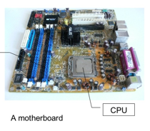
Processing Unit
Motherboard
Motherboard is the central circuit board making up a personal computer.
A personal computer is built with the CPU, main memory, and other essential components on the motherboard.
Other components such as external storage, controller for video display and sound, and peripheral devices are typically attached to the motherboard via edge connectors and cables.
In modern computers, it’s increasingly common to integrate these “peripherals” into the motherboard.

Slide 12
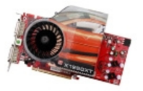
Processing Unit
Video Card
It’s to generate and output images to a display
If the video card is integrated in the motherboard, it will use the computer RAM memory (lower throughput). If it’s not integrated, the video card will have its own video memory which is called Video RAM (VRAM).
The VRAM capacity of most modern video card range from 128 2024 MB (workstation graphic cards)
In 2006, the VRAM was based on DDR technology, standing out DDR2, GDDR3, GDDR4. The memory clock rate is between 400MHz and 1.6 GHz.
A very important element of the video memory is the Z-buffer, which manage the depth coordinates in 3D graphics

Slide 13
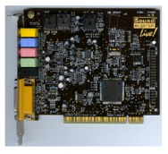
Processing Unit
Sound Card
It’s a computer expansion card that can input and output sound under control of computer programs.
Many computer have sound capabilities built in on the motherboard, while others require these expansion cards if audio capability is desired.

Slide 14
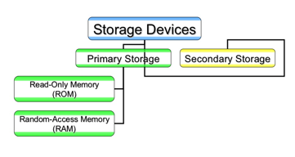
Storage Device
Types of Storage Device

Slide 15
Storage Device Primary Storage
A computer memory that is directly accessible to the CPU of a computer without the use of computer’s input / output channel.
It’s used to store data that is likely to be in active.

Slide 16
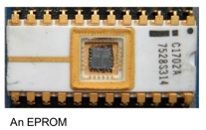
Storage Device Primary Storage
ROM (Read Only Memory)
It’s a class of storage media used in computers
Data stored in ROM can’t be modified
ROM is a non-volatile storage. Data remains unchanged even after switching off the computer
E.g: EPROM, EEPROM

Slide 17
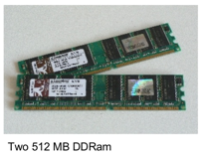
Storage Device Primary Storage
RAM (Random Access Memory)
It’s a type of data storage used in computers
It takes the form of integrated circuits that allow the stored data to be accessed in any order (random)
Data stored in RAM can be modified
RAM is a volatile storage. Data will lose after switching off the computer
E.g: DDRAM, DDR-2 Ram

Slide 18
Storage Device Secondary Storage
It’s computer memory that is not directly accessible to the CPU of computer, requiring the use of computer input / output channels
It’s use to store data that is NOT in active use.
It’s usually slower than primary storage but it always has higher storage capacity
It’s non volatile. Data remains unchanged even after switching off the computer.

Slide 19
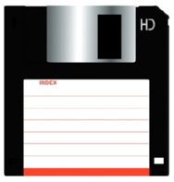
Storage Device Secondary Storage
3.5” Floppy Disk
Data can be read or write
Data capacity: 1.44 MB

Slide 20
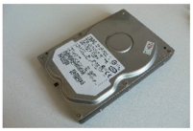
Storage Device Secondary Storage
Hard Disk
Data can be read or write
Speed of disk rotation usually 7200 rpm
Data capacity: 80 GB, 160 GB, 250 GB, 300 GB, etc.

Slide 21
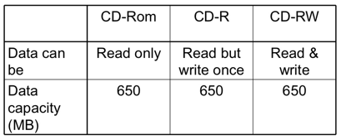
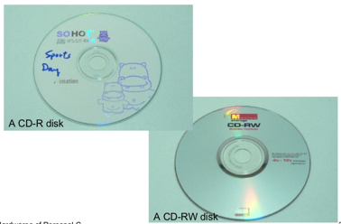
Storage Device Secondary Storage

Slide 22
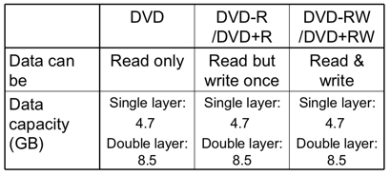
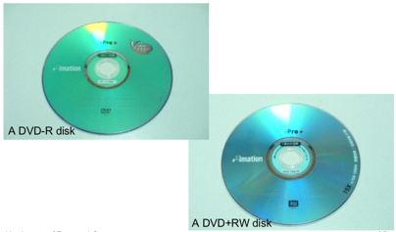
Storage Device Secondary Storage

Slide 23
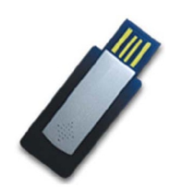
Storage Device Secondary Storage
USB Flash Drive
A memory data storage devices integrated with a USB interface
It’s typically small, lightweight, removable and rewritable
Data capacity: 512 MB, 1 GB, 2 GB, 4 GB, etc

Slide 24
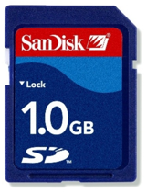
Storage Device Secondary Storage
Memory Card
E.g: SD Card, CF Card, xD Card, Micro Drive, Memory stick.
Data can be read or write
Data capacity: 512 MB, 1 GB, 2 GB, 4 GB, etc

Slide 25
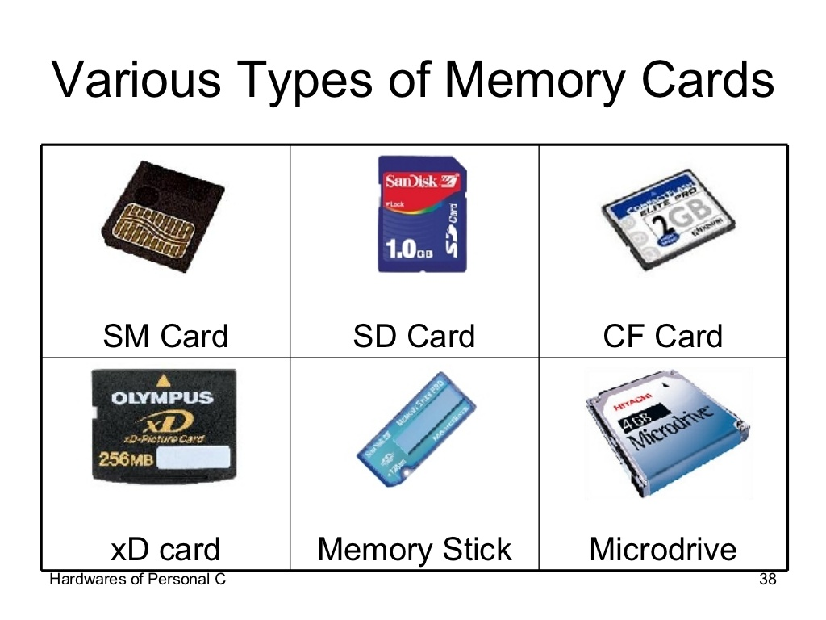
Storage Device Secondary Storage

Slide 26
Output Device
It’s include any hardware that translate information processed by the computer into a form that humans can understand.

Slide 27
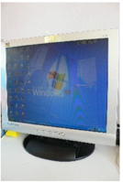
Output Device
Monitor
It’s a piece of electrical equipment which displays text and image
It generated a temporary record because the record disappear when power off
There are 2 major types of monitor: Cathode Ray Tube (CRT) and Liquid Crystal Display (LCD)

Slide 28
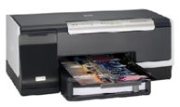
Output Device
Inkjet Printer
It’s operates by propelling tiny droplets of liquid ink onto paper
They are the most common type of computer printer for the general consumer due to their low cost, high quality of output, capability of printing in vivid color, and ease to use

Slide 29
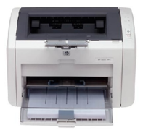
Output Device
Laser Printer
Laser printers employ xerographic printing process
It’s available in both color and black & white varieties

Slide 30
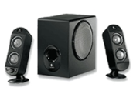
Output Device
Loud Speaker
It’s an electromechanical transducer which convert an electrical signal into sound

Slide 31

BASIC TROUBLESHOOTING

Slide 32
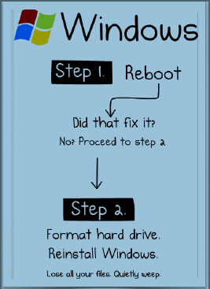
General Troubleshooting

Slide 33
The First Line of Defense
LET’S ALL SING THE REBOOT SONG!
./~ WHEN IN DANGER, OR IN DOUBT,
RUN IN CIRCLES, SCREAM AND SHOUT:
REBOOT! REBOOT! ./~

Slide 34
General Troubleshooting Steps
Is it plugged in?
Is the monitor turned on?
Reboot!
Check that all cords and cables are connected tightly
Check that all cords and cables are connected to the correct port
Have you added a new device recently? Try disconnecting it

Slide 35

Power Issues

Slide 36
Computer Won’t Turn On
Are power cables connected tightly to all devices?
Are power cables plugged in to a power source?
If you are using a surge protector power strip, Has it tripped?
Unplug the computer completely from the power source, wait for 5 minutes, then reconnect and try again

Slide 37
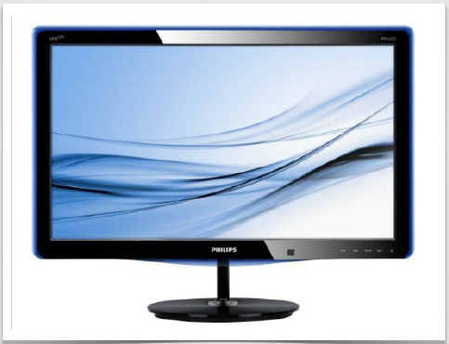
Display Issues

Slide 38
Monitor is not working
Are monitor and computer both turned on?
Are all cables connected properly?
Check screen brightness and contrast settings
Try pressing the space bar several times to wake computer from sleep mode

Slide 39
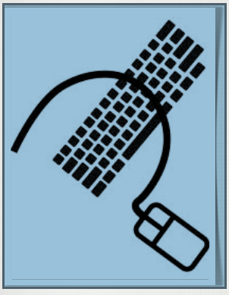
Mouse & Keyboard

Slide 40
Mouse and Keyboard not working
Are cable connected tightly?
If it’s a USB device, try connecting to a different USB port
Reboot! Reboot….!
Make sure mouse is clean and on a solid surface
Try a different mouse or keyboard to determine if it’s a device or computer problem

Slide 41
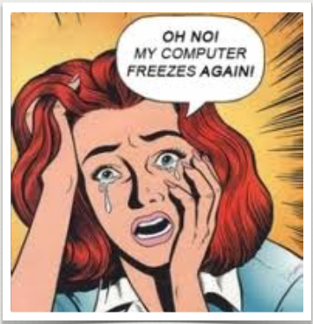
Freezing & Crashing

Slide 42
Computer is Freezing and / or Crashing
Sing reboot song!
Three finger salute “CLTR + ALT + DEL” to close unresponsive programs
If “CLTR + ALT + DEL” not working, hold in power button on CPU until it shut down, the restart
Have you install any new software? Try removing it to see if it is the cause
If you can’t get in to uninstall, reboot in safe mode – press F8 while rebooting – then try to uninstall
Shut down and unplug computer for 5 minutes, then try again

Slide 43
My Computer is to Slow
Disk Cleanup
CCleaner
Defragmentation

Slide 44
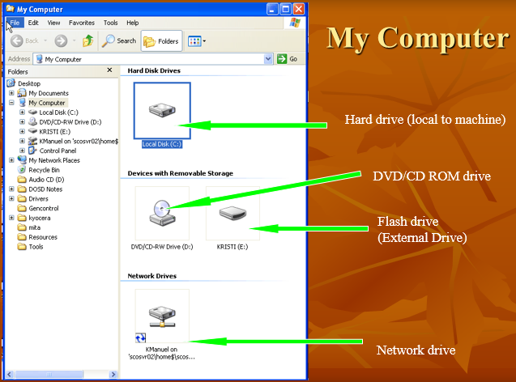

Slide 45
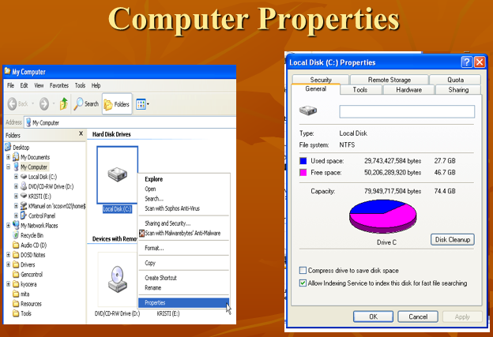

Slide 46
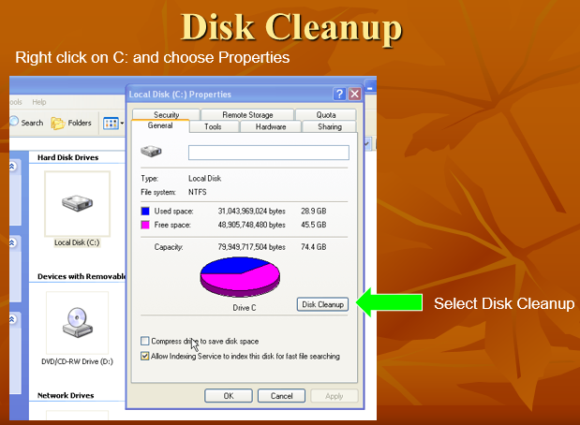

Slide 47
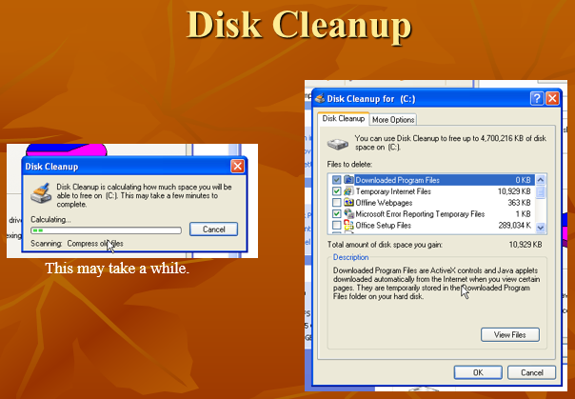

Slide 48
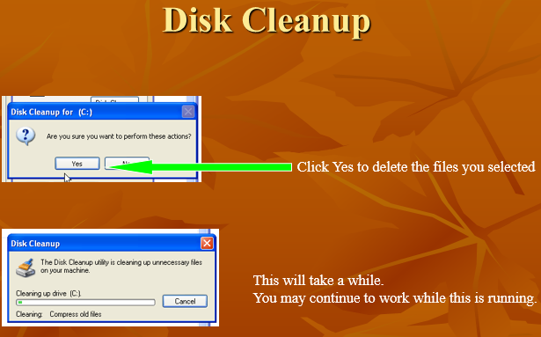

Slide 49
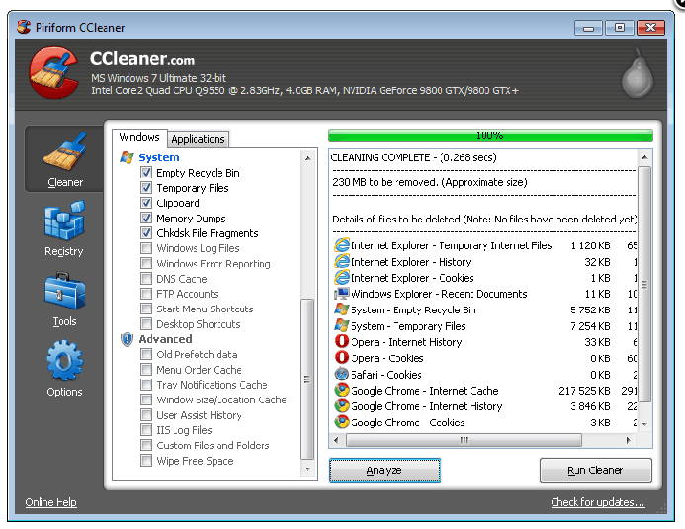
CCleaner
www.ccleaner.com

Slide 50
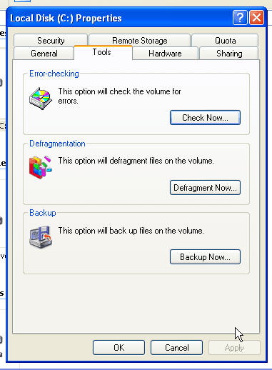
Defragmentation
Right click on C: and choose Properties
Select Tools Tab
Select Defragment Now

Slide 51
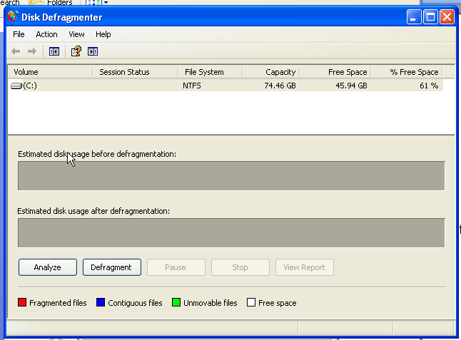
Defragmentation
Select Analyze

Slide 52
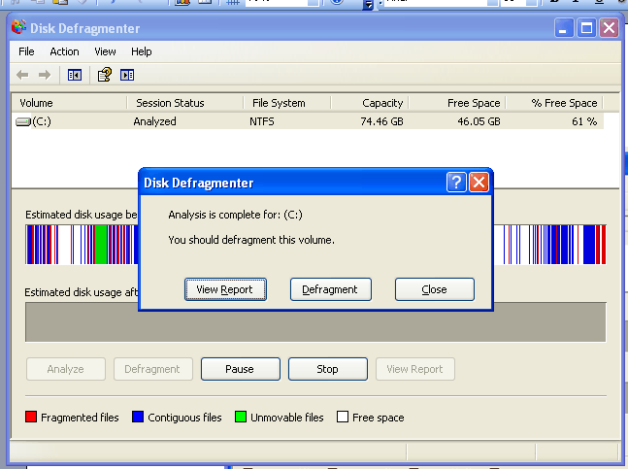
Defragmentation

Slide 53
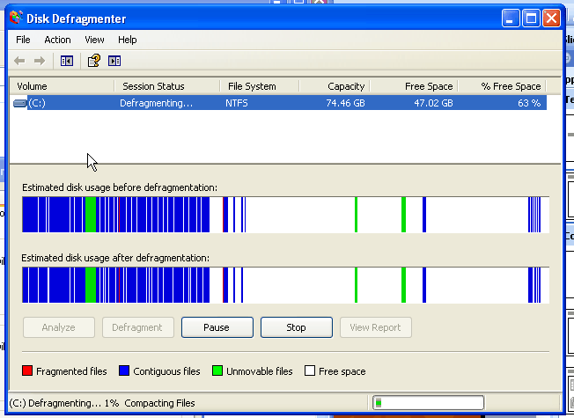
After Defragmenting

Slide 54
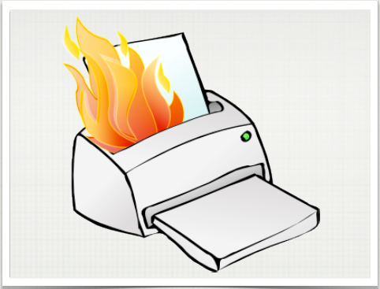
Printer Problems

Slide 55
Printer is not working
Is it plugged in and turned on?
Are you connected to the correct printer?
Is it connected to the computer?
Does it have toner / paper?
Are there any messages on the display?
Unplug, wait for 5 minutes, plug back in
Check printer settings to make sure it is online and not paused
➔ Start – control panel – printer & faxes

Slide 56

Sound Issues

Slide 57
Sound is not working
Are headphone / speakers plugged in tightly?
Are they plugged in to the correct port?
Are speakers power on?
Check volume control on headphones / speakers
Check speaker icon in the system tray to make sure it’s not muted or on very low volume

Slide 58
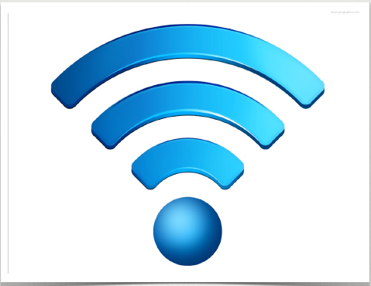
Network Issues

Slide 59
It Can’t Connect to The Network
Reboot, Reboot!
Is the blue network cable plugged in tightly at both ends?
Is there a green light flashing where the cable plugs into the computer? If not, there may be a problem with the cable or the wall port
Is anyone else having the same issue? It may be a general outage
Try another access point in the room
For wireless network:
Are connected to the correct network? (Guest)
Is your WiFi on the computer turned on?

Slide 60
Internet
Deleting Browsing History
Setting Home Page
Toolbars/Popup Blockers
Favorites

Slide 61
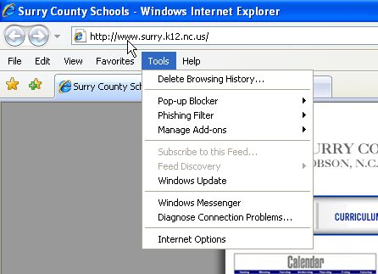
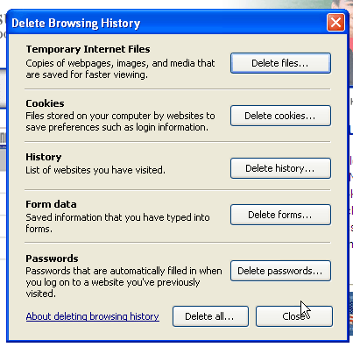
Deleting Browsing History
Select Delete Browsing History
You can delete them individually
Or all at once

Slide 62
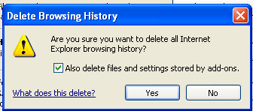
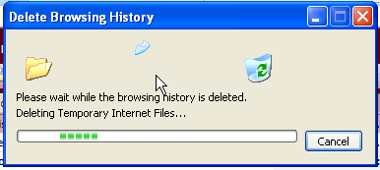
Deleting Browsing History
Click Yes
This may take a while based on the amount
of files you have.

Slide 63
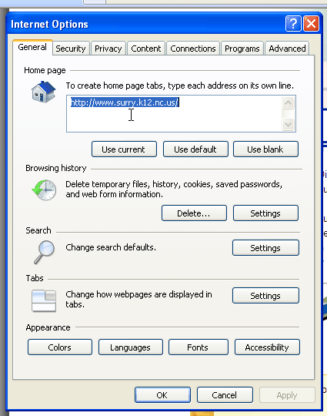
Setting Home Page
Enter the web page you prefer
Choose Tools from Menu Bar
Select Internet Options

Slide 64
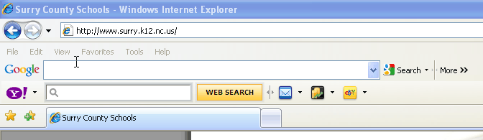
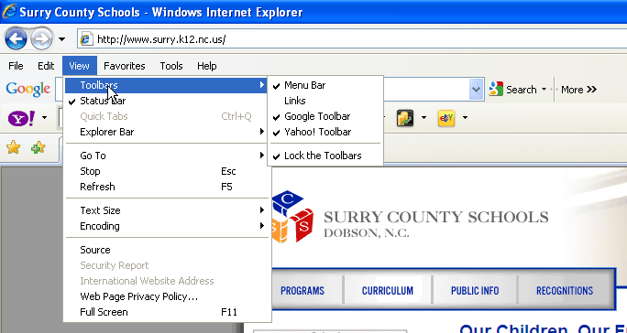
Toolbars and Popup Blockers
Two of the most popular toolbars are Google and Yahoo.
There are numerous others. (i.e. Ask.com, Weather Channel, etc.)
You can hide them or simply uninstall them in in Add and Remove Programs.
Uncheck

Slide 65
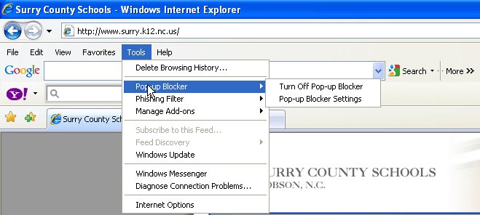
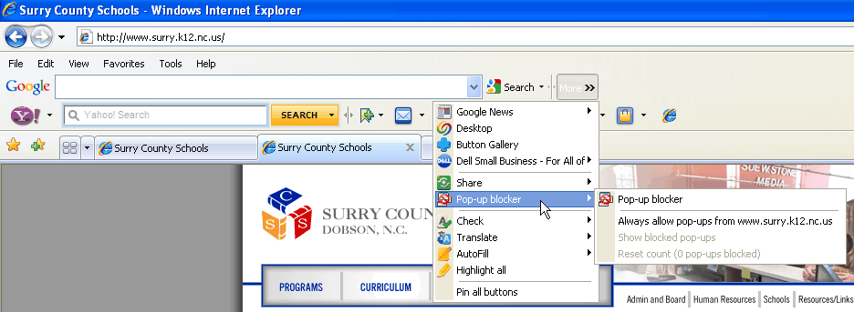
Popup Blockers
Internet Explorer’s Version
Google’s Version

Slide 66


Favorites
Or

Slide 67

Organize Favorites
You can create folders several ways.
Click New Folder
Right click and select New Folder
You can move links also.
Click Move and select where you
would like them
Drag and drop

Slide 68

Error Messages

Slide 69
Oh No, An Error!
Read error messages carefully
Some error messages can be scams
When it doubt, google it!
Write down error messages and include them with any tech support request. It will make your tech happy!

Slide 70

Login Issues

Slide 71
It Can be Logged In
Are you typing your user name and password correctly?
Are caps lock and num lock on? Turn them off!
Make sure the login boxes are empty –especially in the LAB the kids like to put spaces in the username box- which are invisible

Slide 72

BSOD

Slide 73
Blue Screen of Death
This is usually the kiss of death
If rebooting doesn’t work, contact the tech support

Slide 74

Prevention & Maintenance

Slide 75
Keep It Running
Reboot periodically
Keep away from chalk dust & magnets
Empty recycle bin
Run disk defragmenter every other month
➔Start → Program → Accessories → System tools → Disk Defragment
Clean out the temporary internet files folder.
From your browser, go to tools → internet options and use the delete files option. It’s also a good idea to delete cookies and locally cached files in your browser periodically.

Slide 76

Other Tips

Slide 77
Things to Remember
Always save important drive in your D Drive. Otherwise you may also lose them if your computer dies.
Tech support cannot respond to direct email –Please use the tech support form on the website.
Don’t forget the reboot song!

Slide 78
Questions
What is a dual core, core 2 duo, core 2 quad?
What is the difference between core i3, core i5 and core i7?
What is the AMD Ryzen processor, Athlon, and FX processor?
What is the difference of hard disk: IDE, ATA, SATA, SCSI, and SSD

